Slide 1
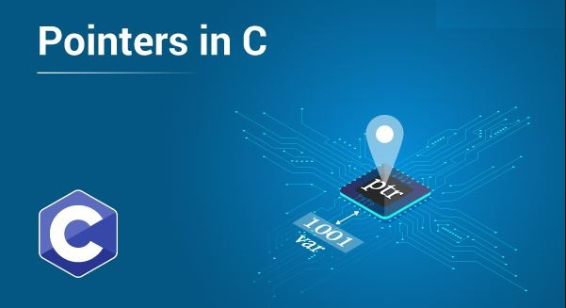

Slide 2
Pointer
Pointer is a special type of variable that is used to store address of a variable. When we declare a variable it is preceded by asterisk (*). While storing address of variable a variable is preceded by ampersand (&).
A pointer can be incremented / decremented, i.e., to point to the next / previous memory location. The purpose of pointer is to save memory space and achieve faster execution time.

Slide 3
Pointer
Key Points
Normal variable stores the value whereas pointer variable stores the address of the variable.
The content of the C pointer always be a whole number i.e. address.
Always C pointer is initialized to null, i.e. int *p = NULL.
The value of null pointer is 0.
& symbol is used to get the address of the variable.
* symbol is used to get the value of the variable that the pointer is pointing to.
If a pointer in C is assigned to NULL, it means it is pointing to nothing.

Slide 4
Pointer
Key Points
Two pointers can be subtracted to know how many elements are available between these two pointers.
But, Pointer addition, multiplication, division are not allowed.
The size of any pointer is 4 byte (for 64 bit compiler).
NOTE: Using pointer we can find address of a variable as well as value of variable.

Slide 5
Pointer
Declaration
Data_Type *Pointer_Name;
Example:
int *ptr;
int x; int x = 10;
ptr = &x; int *ptr = &x;
Pointer
Storing Address

Slide 6
Pointer
Example - 1
#include<stdio.h>
int main()
{
int a = 20;
printf("Address of a = %u\n",&a);
printf("Value of a = %d",a);
return 0;
}
NOTE: Address without pointer
OUTPUT
Address of a = 648758
Value of a = 20

Slide 7
Pointer
Example - 2
#include <stdio.h>
int main()
{
int *ptr, q;
q = 50;
ptr = &q;
printf("Value of q = %d\n",q);
printf("Address of q = %d\n",ptr);
printf("Value of q by pointer = %d",*ptr);
return 0;
}
OUTPUT
Value of q = 50
Address of q = 648758
Value of q by pointer = 50

Slide 8
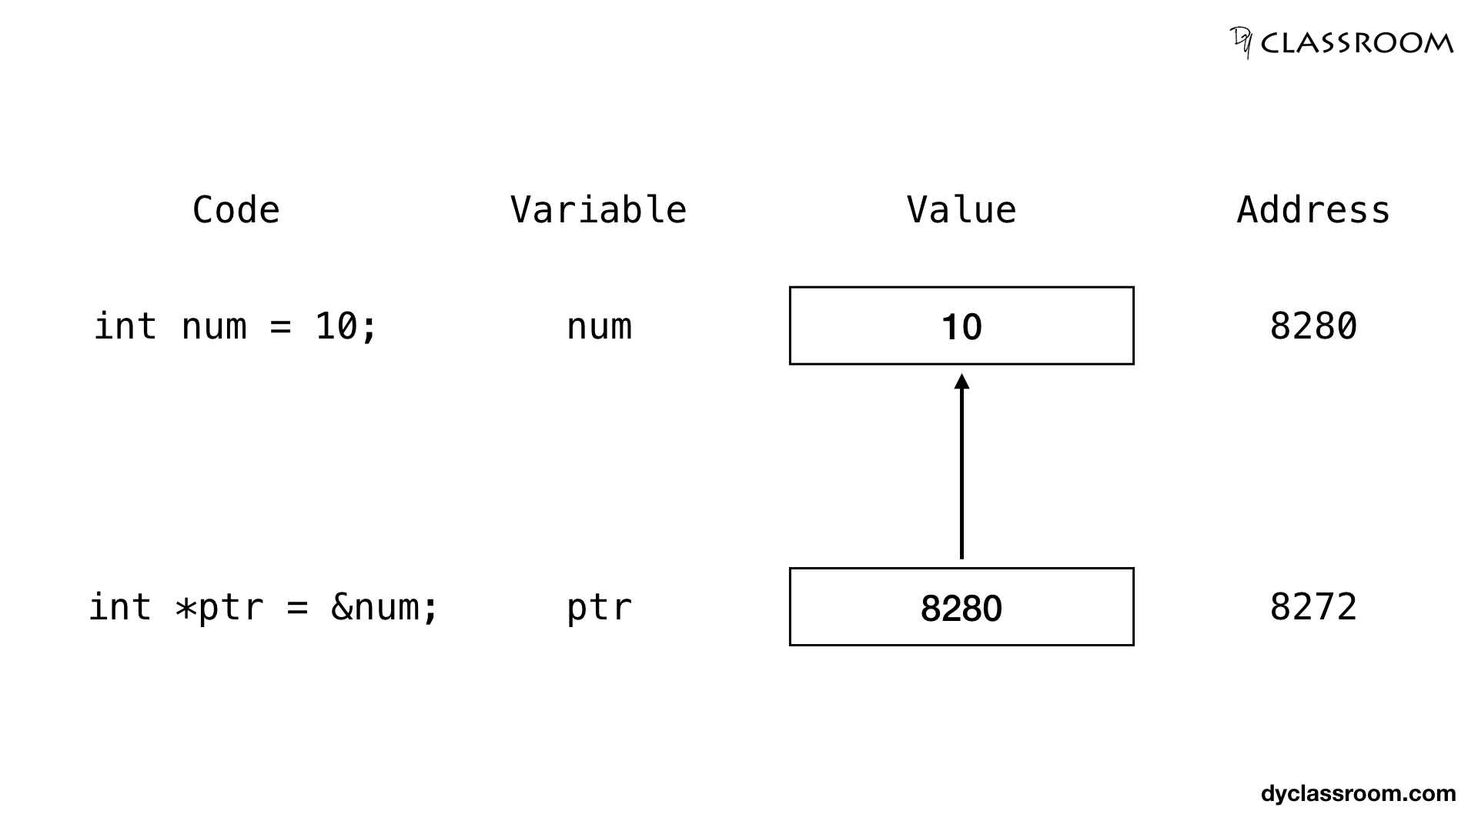
Pointer
Graphical
We can change the value of variable using address.

Slide 9
OUTPUT
Value of num = 10
Value of num (using pointer = 10
Value of num = 20
Value of num (using pointer = 20
Pointer
Example - 2
#include <stdio.h>
int main()
{
int num = 10;
int *ptr = &num;
printf("value of num: %d\n", num);
printf("value of num: (using pointer): %d\n", *ptr);
*ptr = 20;
printf("value of num: %d\n", num);
printf("value of num (using pointer): %d\n", *ptr);
return 0;
}

Slide 10
Pointer
Types
There are eight different types of pointers which are as follows −
Null pointer
Void pointer
Wild pointer
Dangling pointer

Slide 11
Pointer
Null Pointer
You create a null pointer by assigning the NULL value at the time of pointer declaration.
This method is useful when you do not assign any address to the pointer. A null pointer always contains value 0.

Slide 12
Null Pointer
Example - 1
#include <stdio.h>
int main()
{
int *ptr = NULL; //null pointer
printf("The value of ptr is: %d",ptr);
return 0;
}
OUTPUT
The value of ptr is: 0

Slide 13
Pointer
Void Pointer
It is a pointer that has no associated data type with it. A void pointer can hold addresses of any type and can be typecast to any type.
It is also called a generic pointer and does not have any standard data type. It is created by using the keyword void.

Slide 14
Void Pointer
Example - 1
#include<stdio.h>
int main()
{
int a = 2;
char b = 'A';
float f = 3.5f;
void *ptr;
ptr = &a;
printf("Typecasting a = %d\n", *(int *)ptr);
ptr= &b;
printf("Typecasting b = %c\n", *(char *)ptr);
ptr = &f;
printf("Typecasting f = %f", *(float *)ptr);
return 0;
}
OUTPUT
Typecasting a = 2
Typecasting b = A
Typecasting f = 3.500

Slide 15
Pointer
Wild Pointer
If a pointer isn't initialized to anything, it's called a wild pointer. Wild pointers are also called uninitialized pointers.

Slide 16
Wild Pointer
Example - 1
#include <stdio.h>
int main()
{
int *p; //wild pointer
printf("%d",*p);
return 0;
}
OUTPUT
Segmentation fault

Slide 17
Pointer
Dangling Pointer
A dangling pointer is a pointer that refers to a memory location that has been released or deleted.

Slide 18
Dangling Pointer
Example - 1
#include <stdlib.h>
#include <stdio.h>
int main()
{
int *ptr = (int* )malloc(sizeof(int));
printf("Size of *ptr is : %d\n",sizeof(ptr));
free(ptr);
printf("Value of *ptr is %d ", *ptr);
ptr = NULL;
return 0;
}
OUTPUT
Segmentation fault

Slide 19
Call by Value and Call by Reference
Functions can be invoked in two ways: Call by Value or Call by Reference. These two ways are generally differentiated by the type of values passed to them as parameters.
The parameters passed to function are called actual parameters whereas the parameters received by function are called formal parameters.

Slide 20
Call By Value
In this parameter passing method, values of actual parameters are copied to function’s formal parameters and the two types of parameters are stored in different memory locations. So any changes made inside functions are not reflected in actual parameters of the caller.

Slide 21
Call By Value
Example - 1
OUTPUT
a = 10 b = 20
x = 20 y = 10
#include <stdio.h>
void swap(int x, int y)
{
int t;
t = x;
x = y;
y = t;
printf("x = %d\n”,x);
printf(“y = %d\n",y);
}
int main()
{
int a = 10, b = 20;
printf("a = %d\n”,a); printf(“b = %d\n“,b);
swap(a, b);
return 0;
}

Slide 22
Call By Reference
Both the actual and formal parameters refer to the same locations, so any changes made inside the function are actually reflected in actual parameters of the caller.

Slide 23
Call By Reference
Example - 1
OUTPUT
x = 20 y = 10
a = 20 b = 10
#include <stdio.h>
void swap(int *x, int *y)
{
int t;
t = *x;
*x = *y;
*y = t;
printf("x = %d\n”,x);
printf(“y = %d\n",y);
}
Formal Parameter
int main()
{
int a = 10, b = 20;
printf("a = %d\n”,a); printf(“b = %d\n“,b);
swap(&a, &b);
return 0;
}

Slide 24
Pointer
Arithmetic
We can perform arithmetic operations on the pointers like addition, subtraction, etc. In pointer-from-pointer subtraction, the result will be an integer value. Following arithmetic operations are possible on the pointer in C language:
Increment
Decrement
Addition
Subtraction
Comparison

Slide 25
Pointer
Incrementing
If we increment a pointer by 1, the pointer will start pointing to the immediate next location. This is somewhat different from the general arithmetic since the value of the pointer will get increased by the size of the data type to which the pointer is pointing.
The Rule to increment the pointer is given below:
new_address= current_address + i * size_of(data type)
NOTE: Where i is the number by which the pointer get increased.

Slide 26
Pointer Incrementing
Example - 1
#include<stdio.h>
int main()
{
int number=50;
int *p;
p=&number;
printf("Address of p = %u",p);
p = p + 1;
printf("After increment:”);
printf(“Address of p = %u \n",p);
return 0;
}
OUTPUT
Address of p = 32100
After increment:
Address of p = 32104

Slide 27
Pointer
Decrementing
Like increment, we can decrement a pointer variable. If we decrement a pointer, it will start pointing to the previous location. The formula of decrementing the pointer is given below:
new_address= current_address - i * size_of(data type)
NOTE: Where i is the number by which the pointer get decreased.

Slide 28
Pointer Decrementing
Example - 1
#include<stdio.h>
int main()
{
int number = 50;
int *p;
p = &number;
printf("Address of p = %u",p);
p = p - 1;
printf("After decrement:”);
printf(“Address of p = %u \n",p);
return 0;
}
OUTPUT
Address of p = 32104
After decrement:
Address of p = 32100

Slide 29
Pointer
Addition
Like increment and decrement to a pointer variable we can add value to the pointer variable.
new_address= current_address + (number * size_of(data type))

Slide 30
Pointer Addition
Example - 1
#include<stdio.h>
int main()
{
int number=50;
int *p;
p=&number;
printf("Address of p = %u",p);
p = p + 3;
printf("After Addition:”);
printf(“Address of p = %u \n",p);
return 0;
}
OUTPUT
Address of p = 32104
After Addition:
Address of p = 32116

Slide 31
Pointer
Illegal Arithmetic with Pointers
There are various operations which can not be performed on pointers. Since, pointer stores address hence we must ignore the operations which may lead to an illegal address.
Address + Address = illegal
Address * Address = illegal
Address % Address = illegal
Address / Address = illegal
Address & Address = illegal
Address ^ Address = illegal
Address | Address = illegal
~Address = illegal

Slide 32
Pointer
Pointer to Pointers (Double Pointer)
As we know that, a pointer is used to store the address of a variable in C. Pointer reduces the access time of a variable. However, In C, we can also define a pointer to store the address of another pointer. Such pointer is known as a double pointer (pointer to pointer). The first pointer is used to store the address of a variable whereas the second pointer is used to store the address of the first pointer.

Slide 33

Pointer
Syntax
Data_Type **Pointer_Name;
Example: int **Ptr;

Slide 34
Pointer
Example - 1
#include<stdio.h>
int main ()
{
int a = 10;
int *p;
int **pp;
p = &a;
pp = &p;
printf(“Address of a: %x\n",p);
printf(“Address of p: %x\n",pp);
printf("value of p: %d\n",*p);
printf("value of pp: %d\n",**pp);
return 0;
}
OUTPUT
Address of a: 10234
Address of p: 20345
Value of p: 10
Value of pp: 10

Slide 35
Pointer
Function Pointer
As we know that we can create a pointer of any data type such as int, char, float, we can also create a pointer pointing to a function. The code of a function always resides in memory, which means that the function has some address. We can get the address of memory by using the function pointer.

Slide 36
Pointer
Simple Example
#include <stdio.h>
int main()
{
printf("Address of main() function is %p",main);
return 0;
}

Slide 37
Function Pointer
Syntax
return_type (*pointer_name)(type1, type2);
Example: int (*fptr) (int);

Slide 38
Function Pointer
Example - 1
#include<stdio.h>
void fun(int a)
{
printf("Value of a is %d\n", a);
}
int main()
{
void (*fun_ptr)(int) = &fun;
(*fun_ptr)(10);
return 0;
}

Slide 39
Function Pointer
Example - 2
#include<stdio.h>
void fun(int a)
{
printf("Value of a is %d\n", a);
}
int main()
{
void (*fun_ptr)(int) = &fun;
(*fun_ptr)(10);
return 0;
}

Slide 40
QUIZ

Slide 41
Quiz - 1
# include <stdio.h>
void fun(int x)
{
x = 30;
}
int main()
{
int y = 20;
fun(y);
printf("%d", y);
return 0;
}
OUTPUT
20
Click here to see code

Slide 42
Quiz - 2
#include <stdio.h>
void fun(int *ptr)
{
*ptr = 30;
}
int main()
{
int y = 20;
fun(&y);
printf("%d", y);
return 0;
}
OUTPUT
30
Click here to see code

Slide 43
Quiz - 3
#include <stdio.h>
void fun(int *ptr)
{
*ptr = 30;
}
int main()
{
int y = 20;
fun(&y);
printf("%d", y);
return 0;
}
OUTPUT
30
Click here to see code

Slide 44
Coding Questions

Slide 45
Question - 1
Write a program to take two input from the user and store the address of variable into pointer and find the sum of the numbers using pointer.
Click here to see code

Slide 46
Question - 2
Write a program to take two input from the user and store the address of variable into pointer and find the sum of the numbers using call by reference.
Click here to see code

Slide 47
Coding Questions
Write a C program to find cube of any number using function.
Write a C program to find diameter, circumference and area of circle using functions.
Write a C program to find maximum and minimum between two numbers using functions.
Write a C program to check whether a number is even or odd using functions.
Write a C program to check whether a number is prime, Armstrong or perfect number using functions.
Write a C program to find all prime numbers between given interval using functions.
Write a C program to print all strong numbers between given interval using functions.
Write a C program to print all Armstrong numbers between given interval using functions.
Write a C program to print all perfect numbers between given interval using functions.
Write a C program to find power of any number using recursion.

Slide 48
Coding Questions
11. Write a C program to calculate area of square using return function.
12. Write a program to calculate area and parameter of rectangle.
13. Write a program to check if entered character is alphabet or not using return function with argument.
14. Write a C program to check entered number is even or odd using return with argument function.
15. Write a C program to print sizes of different types of pointer (Like integer, character, long int, float, double etc.
16. Write a program to demonstrate double pointer.
17. Write a program to change the value of a variable using pointer.
18. Write a program to print the Fibonacci series up to specified number.

Slide 49
Coding Questions
19. Write a C program to call simple method using function pointer.
20.

